Slide 1


Student Reminder App
Name: Tiisetso Matabane
Student no: 202240101
Module: NHCI63110 – Human-Computer Interaction

Slide 2
Topics:
User Research, Personas, Scenarios
Conceptual Model & Interaction Thinking
Interface Sketches
Django Wireframe (structure & layout)
Evaluation Plan
Reflection

Slide 3

User Research
Students at SPU struggle to manage academic tasks while maintaining well-being.
Main Points:
- Missed deadlines
- Burnout from poor work-life balance
- Disconnected scheduling tools

Slide 4
Personas
Participants: 3 students interviewed
Insights:
- Need for centralized platform
- Smart break reminders
- Visual progress tracking
- Easy access to mental health resources

Slide 5
Personas
🧑 Thabo – Final-year CS student
- Overwhelmed by project deadlines, forgets to take breaks
👩 Lerato – First-year ICT student
- Needs time management support, experiences anxiety

Slide 6
Scenarios
Scenario 1: Thabo receives a break reminder after 2 hours of focused study.
Scenario 2: Lerato views a color-coded calendar to plan her day with wellness breaks.

Slide 7
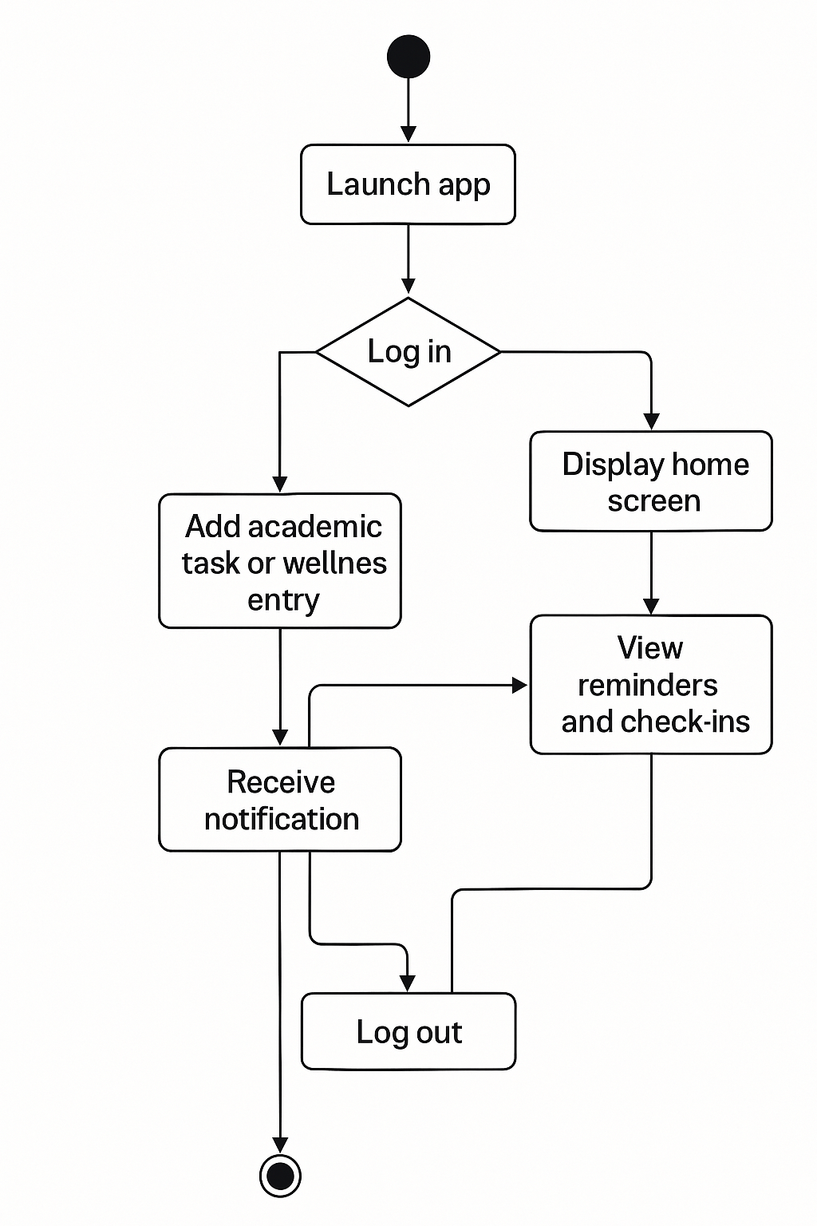
Conceptual Model Diagram

Slide 8

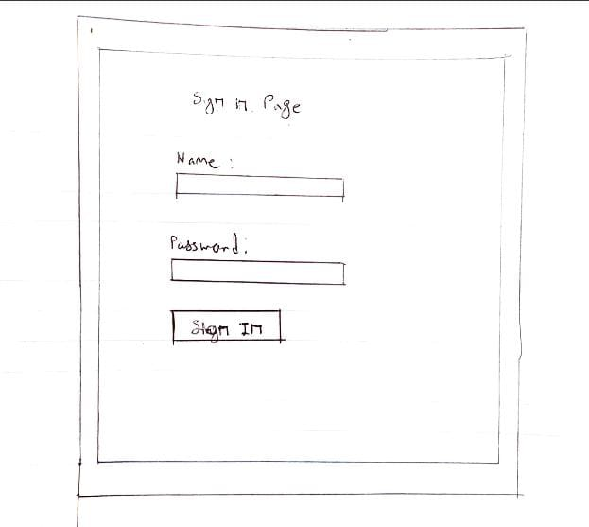
Interface Sketches

Slide 9
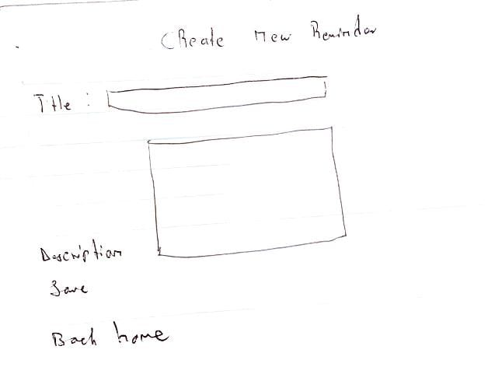
Interface sketches

Slide 10
Annotations
Annotations:
Visibility (Clear Priorities)
Calendar , Tasks , and Wellness ,icons are prominently placed at the top for quick access.
Task list is prioritized over other elements (larger font, centered).
Feedback (Interactive Elements)
Mood selector shows immediate visual feedback (e.g. highlights when selected).
Task checkboxes update with a checkmark when clicked.
Constraints (Guided Actions)
"Submit" button for mood check-in is disabled until a mood is selected (grayed out).
No delete option on the dashboard—users must navigate to a dedicated "Edit Tasks" screen
GITHUb link
. https://github.com/Tiisetso-githb/HCI-TIISETSO.git

Slide 11
Core Features
✔ Task & Reminder Management
✔ Calendar Integration
✔ Smart Notifications

Slide 12
Django wireframe
Interaction Types:
- Instructing (forms, buttons)
- Conversing (wellness chatbot)
- Exploring (calendar)
Metaphor: 🗓️ Digital Wellness Planner – like a smart journal + wellness coach

Slide 13
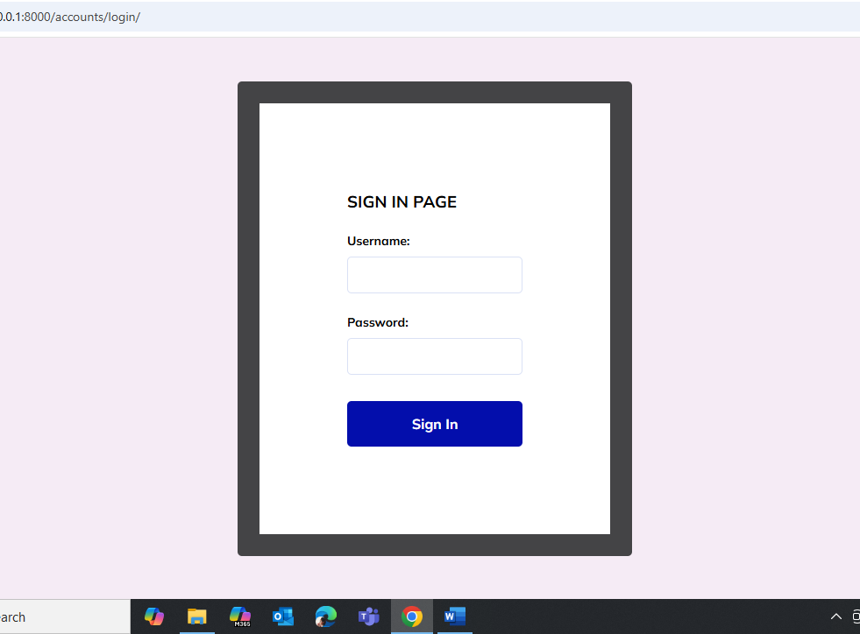

Slide 14
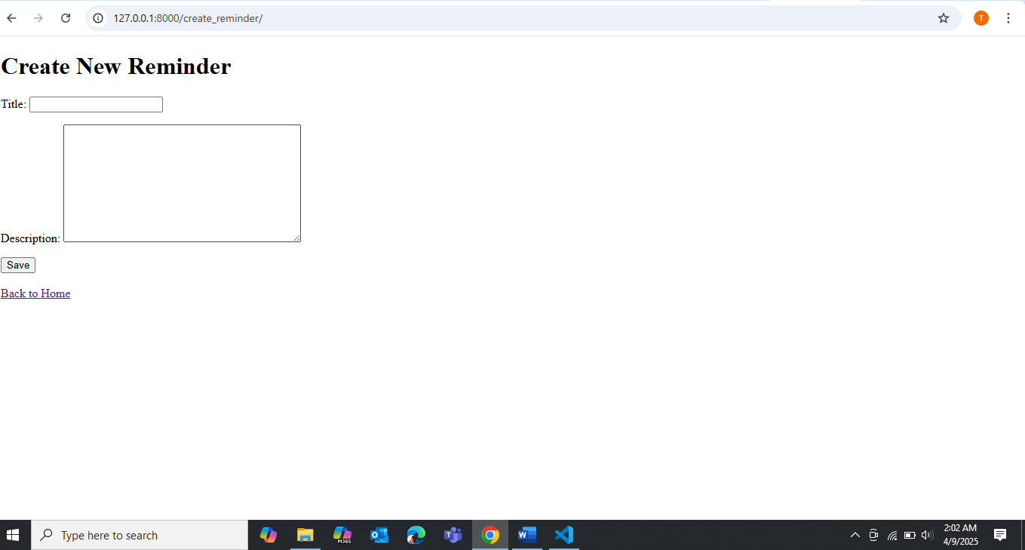
Screenshot

Slide 15
Evaluation Plan
Goals:
- Complete task in ≤30 seconds
- Improve user control by 20% in 1 week
Method: Think-Aloud with 5 students
Questions:
- Was the interface intuitive?
- Were reminders helpful or annoying?

Slide 16

Reflection
Learnings:
- Importance of listening to users
- Concept modeling clarified app structure
- Wireframes helped reveal real limitations
Next time: Do more low-fi sketches before coding

Slide 17
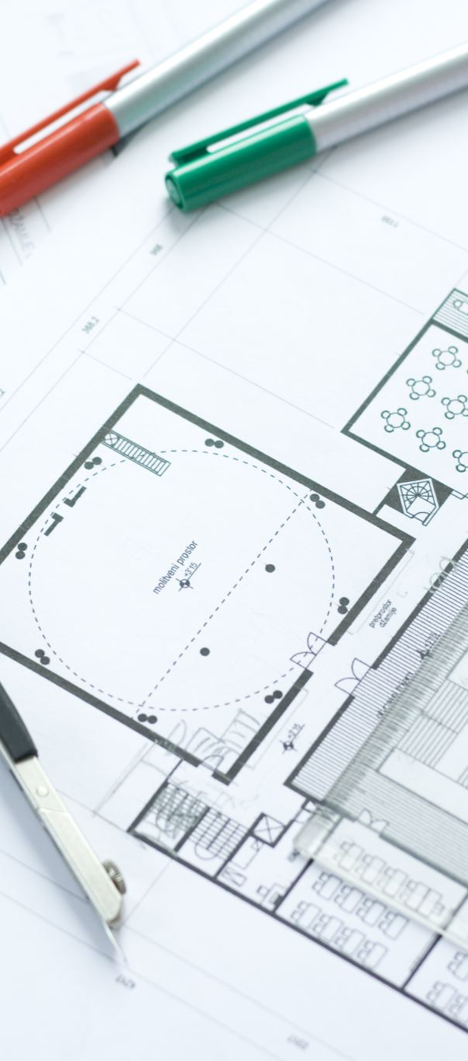
Conclusion & Next Steps
Conclusion:
A tool that supports both academic planning and student wellness—designed with real student needs in mind.
Next Steps:
- User testing
- Iterative refinement
- Build working prototype

